Slide 1

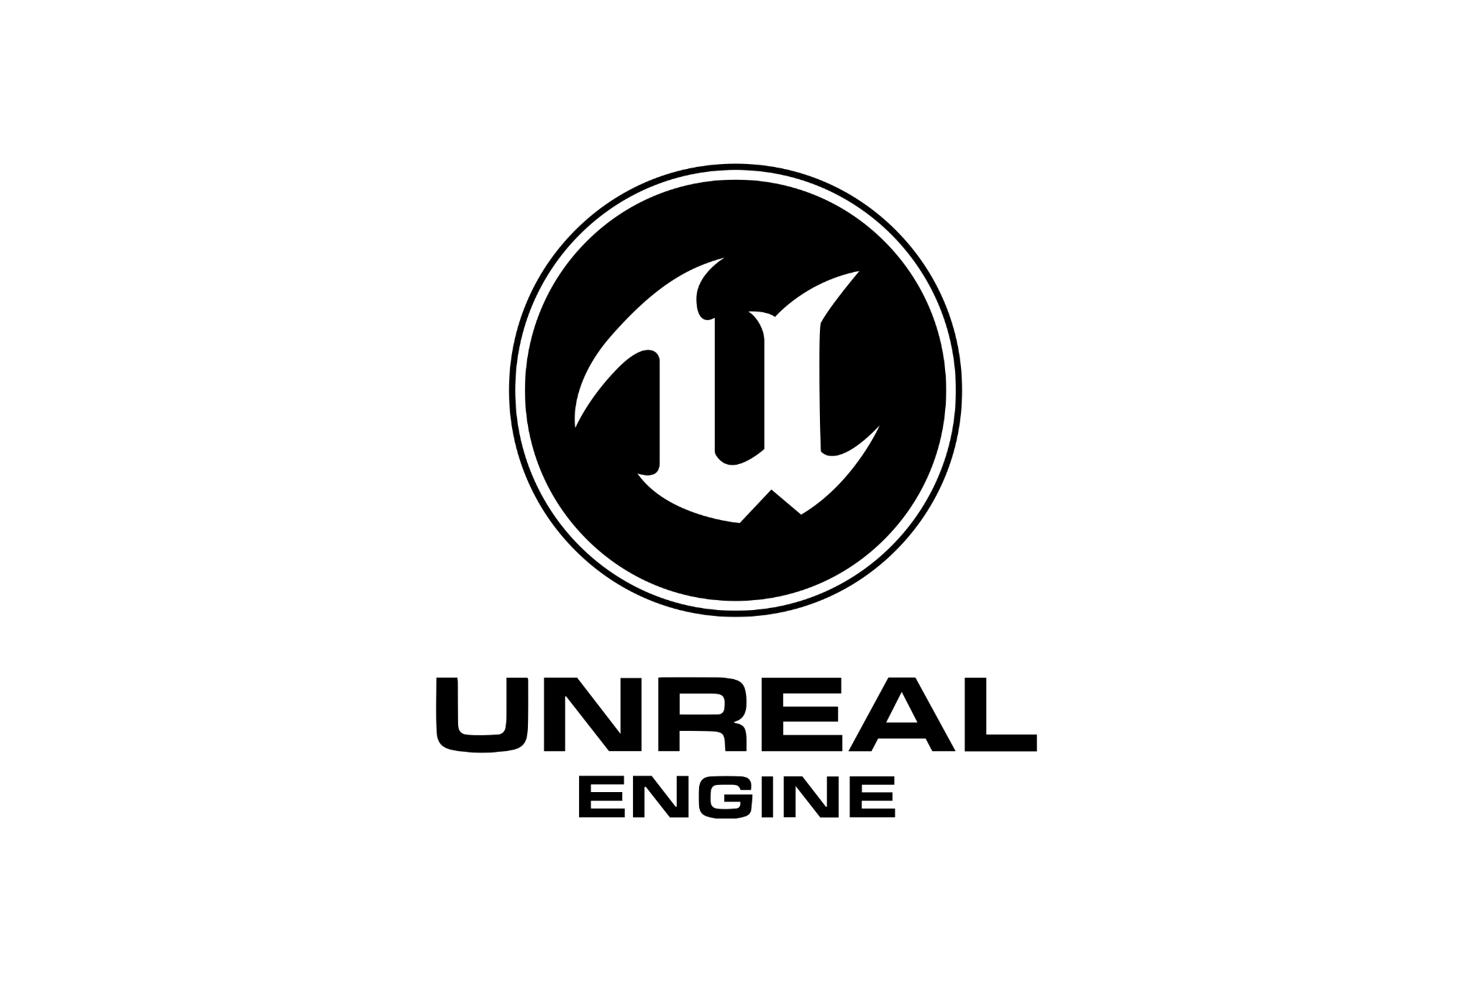





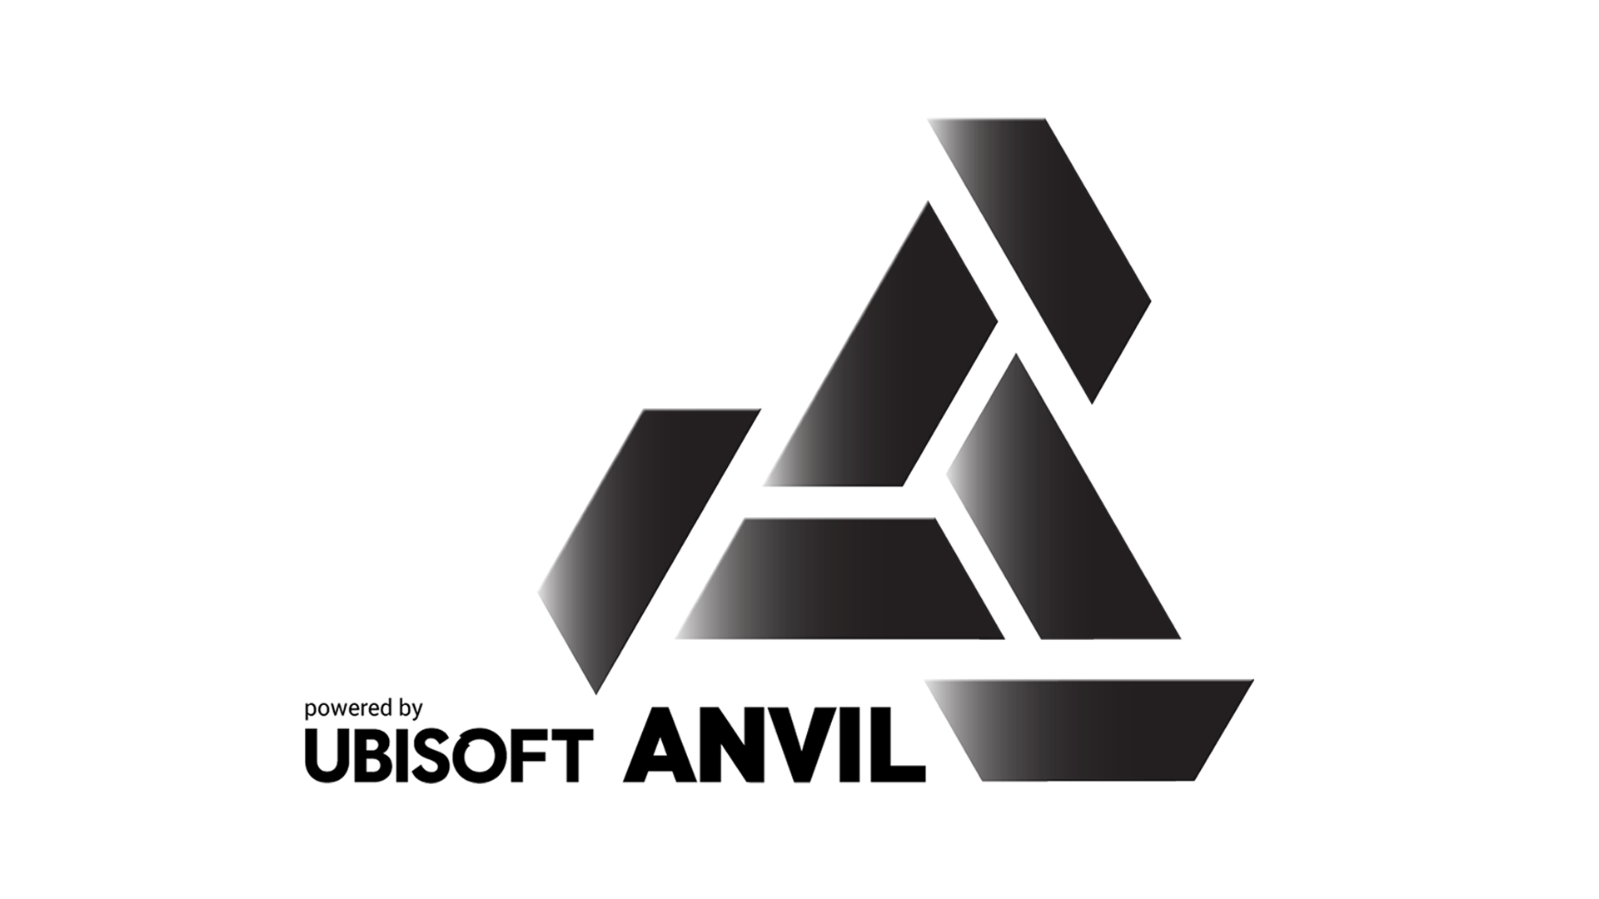


Lesson 1
Game engines
Nicolas Serf
serf.nicolas@gmail.com

Slide 2

What is a game engine ?

Slide 3

What is a game engine ?
Toolbox

Slide 4






Reusability
Accessibility
Open / Close
LIbraries
What is a game engine ?
Plugins
Core
Definition
1. Toolbox
Libraries concept is not only tied to game development and game engine, but a general concept of doing reusable piece of code encapsulated into an external library not tied to a specific project
2. AI
3. Input / output
4. Physics
Examples
5. Rendering
Physics, Mathematics, Rendering, Etc…
6. UI
7. Network
8. Building & Shipping
9. Multi-platform

Slide 5
Libraries
Accessibility
Open / Close
Reusability
What is a game engine ?
Plugins
Core
Definition
1. Toolbox
Reusability is kind of the key definition of a game engine, every features made by game engine developers are focused on reusability without any project dependency
2. AI
3. Input / output
4. Physics
Examples
5. Rendering
Pathfinding, Rendering pipeline, Occlusion culling, etc…
6. UI
7. Network
8. Building & Shipping
9. Multi-platform

Slide 6
Libraries
Reusability
Open / Close
Accessibility
What is a game engine ?
Plugins
Core
Definition
1. Toolbox
An important part of a game engine is the accessibility of the engine. It differs from engine to engine, but it is important to be usable by a developer but also non-developers for some parts.
2. AI
3. Input / output
4. Physics
Languages
5. Rendering
This is not the only factor determining accessibility, but coding language used in engine are important in that subject. Each game engine is associated with 1+ coding languages.
6. UI
7. Network
8. Building & Shipping
9. Multi-platform

Slide 7
Libraries
Reusability
Accessibility
Open / Close
What is a game engine ?
Plugins
Core
Definition
1. Toolbox
This is determining for a lot of companies. Some game engines have source code open, some others don’t. Having access to source code, and possibility to build and modify the engine can be essential
2. AI
3. Input / output
4. Physics
Examples
5. Rendering
Unreal engine is not open source, but source code is accessible, Unity is closed, Godot is open source, etc…
6. UI
7. Network
8. Building & Shipping
9. Multi-platform

Slide 8
Libraries
Reusability
Accessibility
Plugins
What is a game engine ?
Open / Close
Core
Definition
1. Toolbox
Plugins can have different name based on the engine, but the concept is similar, it is a bit like an evolved library, which can contains code, assets, external dependencies, etc… and are always optional
2. AI
3. Input / output
4. Physics
Provenance
5. Rendering
Plugins comes either from engine developers, which should ensure to be fully integrated and polished into the engine, or from marketplace or private github, made by the community, free or profitable
6. UI
7. Network
8. Building & Shipping
Examples
9. Multi-platform
Unreal engine have plugins, Unity have packages, etc…

Slide 9
Libraries
Reusability
Accessibility
Core
What is a game engine ?
Open / Close
Plugin
Definition
1. Toolbox
Every engine has a core foundations base classes which give the base hierarchy to access the main framework of the engine, like replication, reflection, etc…
2. AI
3. Input / output
4. Physics
Set in stone
5. Rendering
The core foundation of every engine is kind of set in stone. By that, I mean that if you don’t like and don’t want to works with it, change engine instead of rewriting everything or trying to avoid it.
6. UI
7. Network
8. Building & Shipping
Examples
9. Multi-platform
Unity offers a really light base hierarchy, while unreal’s game framework is massive, explaining the difficulty to learn the engine

Slide 10
What is a game engine ?
AI

Slide 11




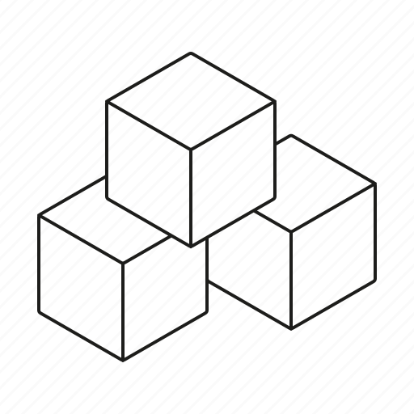
Behaviors
Perception
Environment
Pathfinding
What is a game engine ?
A lot to do
Definition
1. Toolbox
Pathfinding is a key element for every games with AIs. It allows agents to navigate in the level by looking for a possible and optimal path
2. AI
3. Input / output
4. Physics
Implementation
5. Rendering
The implementation may differ from engine to engine, but generally speaking, they are using custom A* with a triangulation of the level based on collisions
6. UI
7. Network
8. Building & Shipping
9. Multi-platform

Slide 12
Pathfinding
Perception
Environment
Behavior
What is a game engine ?
A lot to do
Definition
1. Toolbox
Every agent has a behavior in a game, from simple idle behavior, not interacting at all with the world, to complexe behavior with multiple interaction layer. Behaviors drives the agent actions
2. AI
3. Input / output
4. Physics
Techniques
5. Rendering
There is many techniques known to create behaviors like state tree, behavior tree, FSM, etc… But some engine are lighter on the subject, and do not offer than much
6. UI
7. Network
8. Building & Shipping
Example
9. Multi-platform
Unreal offers various tools to create behaviors, from behavior tree to blackboard, while unity not that much, except Animation and AnimationBehavior which can be hijack to create FSM or BT.

Slide 13
Pathfinding
Behaviors
Environment
Perception
What is a game engine ?
A lot to do
Definition
1. Toolbox
When you want to have agent interact with the world, and more specifically with other agent or players, they need to be aware of the world, through senses and perception
2. AI
3. Input / output
4. Physics
Examples
5. Rendering
You could think of various techniques to perceive the world, the 2 most obvious being sight and hearing. They can be simulated with raycast / shapecast or a bit of logic
6. UI
7. Network
8. Building & Shipping
9. Multi-platform

Slide 14
Pathfinding
Behaviors
Perception
Environment
What is a game engine ?
A lot to do
Definition
1. Toolbox
Environment is another important factor for an agent. If you want your AIs to be aware of the environment like a place to hide, a better spot to fire, etc… This is tied to environment awareness
2. AI
3. Input / output
4. Physics
Examples
5. Rendering
One of the most known technique is EQS which stand for “Environment Query System”. Some engines like Unreal offers to support out of the box from the engine.
6. UI
7. Network
8. Building & Shipping
9. Multi-platform

Slide 15
Pathfinding
Behaviors
Perception
A lot to do
What is a game engine ?
Environment
Definition
1. Toolbox
Globally speaking, AIs subject are kind of tied to gameplay mechanics and project specificities, so there is always a lot to do on a project regarding AIs if you want smart interaction
2. AI
3. Input / output
4. Physics
Examples
5. Rendering
Faction system, World behavior, developing complexe logic of transition and interaction from behavior state, etc…
6. UI
7. Network
8. Building & Shipping
9. Multi-platform

Slide 16

What is a game engine ?
Input / output

Slide 17




Controllers
M&K
Files
Audio
What is a game engine ?
Hardware
Definition
1. Toolbox
Audio is by essence, even more now, a critical part of any games which bring as much as artists and gameplay. It is responsible for bringing to life visual elements, feedbacks, and more
2. AI
3. Input / output
4. Physics
5. Rendering
6. UI
7. Network
8. Building & Shipping
9. Multi-platform

Slide 18
Audio
M&K
Files
Controllers
What is a game engine ?
Hardware
Definition
1. Toolbox
Nowadays, a vast majority of games support controllers, because they’ll either be multi-platform games, or because a lot of players wants to play with controllers. Support them is nearly not an option.
2. AI
3. Input / output
4. Physics
Implication
5. Rendering
Supporting controllers has a lot of implication which can be seen in games. There is way less keys and way to interact with the world, kind of simplifying gameplay
6. UI
7. Network
8. Building & Shipping
Support
9. Multi-platform
Even if it simplify the gameplay, supporting controllers may be challenging. But nowadays, engines tend to understand the challenge, and offers great tools around that

Slide 19
Audio
Controller
Files
M&K
What is a game engine ?
Hardware
Definition
1. Toolbox
A bit like controller, if you target a game for computer, you’ll need to support mouse & keyboard.
2. AI
3. Input / output
4. Physics
Implication
5. Rendering
Mouse & keyboard is actually even more complicated to manage than controller because you need to take into account keyboard localization which will be different if you target international market
6. UI
7. Network
8. Building & Shipping
9. Multi-platform

Slide 20
Audio
Controller
M&K
Files
What is a game engine ?
Hardware
Definition
1. Toolbox
This is obviously part of the input / output implication, you’ll need to read / write files for a game. They are predominant for various things like save, configuration files, etc…
2. AI
3. Input / output
4. Physics
Implication
5. Rendering
There is a lot of implication regarding files management, being dependant from the hardware, the encoding, etc… You’ll either have to manage it, or use tools provided by libraries in the engines
6. UI
7. Network
8. Building & Shipping
9. Multi-platform

Slide 21
Audio
Controller
M&K
Hardware
What is a game engine ?
Files
Definition
1. Toolbox
It will be hidden by most game engine, and you’ll not need to worry about it, but game engine and executable produced will be depend of the hardware of the machine obviously.
2. AI
3. Input / output
4. Physics
Inputs
5. Rendering
Mouse, speakers, headset, etc… are all hardware components which are connected to the console and sending input or receiving output. One of the purpose of a game engine is to properly connect to that
6. UI
7. Network
8. Building & Shipping
9. Multi-platform

Slide 22

What is a game engine ?
Physics

Slide 23




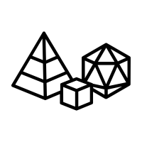
Collisions
Raycasts
Forces
Engine
What is a game engine ?
Primitives
Definition
1. Toolbox
There is a distinction between a game engine and a physic engine. They are 2 things completely different. A game engine will be containing most of the time a custom or commercial physic engine.
2. AI
3. Input / output
4. Physics
Role
5. Rendering
The role of the physic engine is to simulate a world, and provide the physical logic of every element, computing forces, managing collisions, etc…
6. UI
7. Network
8. Building & Shipping
Examples
9. Multi-platform
Some commercial game engine now embedded a custom made physic engine like Chaos for Unreal, but some other, like Unity, uses commercial solution like PhysX made by NVIDIA.

Slide 24
Engine
Raycasts
Forces
Collisions
What is a game engine ?
Primitives
Definition
1. Toolbox
Collisions is one of the most important subject when it comes to physics. It is the mechanism that made sure 2 objets will not pass through each others if they are supposed to collide
2. AI
3. Input / output
4. Physics
Granularity
5. Rendering
We’ll not go into details, but collisions can be expensive, and for the majority of object, collisions are not perfect, but uses primitives on which physic engine can compute much faster
6. UI
7. Network
8. Building & Shipping
Matrix
9. Multi-platform
Often, engine offers a matrix collision which allows to define which type of object should collide with others

Slide 25
Engine
Collisions
Forces
Raycasts
What is a game engine ?
Primitives
Definition
1. Toolbox
Raycast is probably the most basic operation for a physic engine. it consist of firing a ray from a point, to a direction, to determine if that ray hit something
2. AI
3. Input / output
4. Physics
Multi vs single
5. Rendering
All engines offers the possibility for a ray to not be stopped by an object, so you can know every object that get pass through.
6. UI
7. Network
8. Building & Shipping
Examples
9. Multi-platform
Raycast are used in a lot of situation, like checking if an object is in front, testing interaction between mouse and an object, by doing a raycast, for lighting, etc…

Slide 26
Engine
Collisions
Raycasts
Forces
What is a game engine ?
Primitives
Definition
1. Toolbox
Forces is another important element when it comes to physics. There is at any time of simulation forces that get applied to object like gravity for example
2. AI
3. Input / output
4. Physics
Add forces
5. Rendering
Forces generated by environment (like gravity) are not the only forces that can affect an object obviously. You can manually add a force to an object, to make it move, or when it bounces for example
6. UI
7. Network
8. Building & Shipping
Mass
9. Multi-platform
Physic engine and forces are complexe, and tries to simulate as close as possible real physics, so you’ll be given a lot of variables which are implied in force computation like mass, drag, etc…

Slide 27
Engine
Collisions
Raycasts
Primitives
What is a game engine ?
Forces
Definition
1. Toolbox
Like explained a bit earlier, it is better to use primitive shapes which are way easier to computer for physic engine.
2. AI
3. Input / output
4. Physics
Complex
5. Rendering
If you really want precise collision, you can build an object with multiple collider shapes, like a sphere for the head, cube for the torso, etc… or use a complex collision which will match the mesh
6. UI
7. Network
8. Building & Shipping
Examples
9. Multi-platform
There is 4 shapes that are commonly used : Cube, Sphere, Capsule and plane

Slide 28

What is a game engine ?
Rendering

Slide 29





Shaders
Culling
Materials
Engine
What is a game engine ?
Lighting
VFX
Definition
1. Toolbox
Rendering is also an engine by itself, way more tied to engine most likely but still. Rendering engine are wrapper around rendering libraries like DirectX or OpenGL
2. AI
3. Input / output
4. Physics
Role
5. Rendering
The role of rendering engine is to compute every objects in the scene to be fitted into the camera. It includes a lot of processing and computation which are invisible for developers
6. UI
7. Network
8. Building & Shipping
2D / 3D
9. Multi-platform
Some engine are doing a rendering engine which support directly 2D and 3D, by wrapping 2D with 3D. Some others take the decision to do 2 different rendering engine like Unity.

Slide 30
Engine
Culling
Materials
Shaders
What is a game engine ?
Lighting
VFX
Definition
1. Toolbox
Shaders are tiny piece of code which are not like standard c++ code which directly manipulate pixel or fragment of 3D models. A Fragment is a chunk of pixels
Shaders have a variety of usable, like altering position, color, saturation of any vertex
2. AI
3. Input / output
4. Physics
Execution
5. Rendering
Shaders are important because they are executed in parallel on GPU, allowing to do the heavy stuff for rendering that couldn’t be made on CPU. Shaders are responsible for making materials works basically
6. UI
7. Network
8. Building & Shipping
Languages
9. Multi-platform
A shader is associated with a shading language like GLSL, HLSL, etc…

Slide 31
Engine
Shaders
Materials
Culling
What is a game engine ?
Lighting
VFX
Definition
1. Toolbox
Culling is a rendering technique more than important in order to have a proper framerate. It consist of a simple thing : Do not render a pixel which will not be visible
2. AI
3. Input / output
4. Physics
Reason for culling
5. Rendering
There is a lot of reason for culling : part of the mesh is hidden by another mesh, mesh is outside of the camera view, etc…
6. UI
7. Network
8. Building & Shipping
Distinction
9. Multi-platform
While culling is the process of not visually computing some meshes / vertices, it should not be confounded with deletion, a culled mesh will still be logically present regarding collision, etc…

Slide 32
Engine
Shaders
Culling
Materials
What is a game engine ?
Lighting
VFX
Definition
1. Toolbox
Materials are as important as meshes. They are basically an instance of a shader, the application of the code into a mesh in order to give a color, to define how the mesh reflect light, etc…
2. AI
3. Input / output
4. Physics
Textures
5. Rendering
Textures are different from materials, but works in duo with them. Textures are wrapped around a mesh using its UVs. The logical computation of a texture is made with shaders through materials
6. UI
7. Network
8. Building & Shipping
Optimization
9. Multi-platform
Materials being omnipresent in game, there is a bunch of techniques in order to optimize them like doing instances, batching them into 1 draw call, reduce shader complexity, etc…

Slide 33
Engine
Shaders
Culling
Lighting
What is a game engine ?
Materials
VFX
Definition
1. Toolbox
A game without lighting will be completely black. From this statement, it is easy to see how important lighting is. it will bring atmosphere, visibility, and ambiance into the game.
2. AI
3. Input / output
4. Physics
Critical
5. Rendering
As important as they are, lighting is also critical performance wise. Shadows comes from lighting, ambient occlusion comes from lighting, etc… and all this can cost a lot and quickly escalate
6. UI
7. Network
8. Building & Shipping
Type
9. Multi-platform
They is various type of lighting, from simple point light to directional light, you’ll be bringing life to a scene by simulating the sun, the moon, lanterns, lamp post, etc… thanks to lights

Slide 34
Engine
Shaders
Culling
VFX
What is a game engine ?
Materials
Lighting
Definition
1. Toolbox
VFX are important to any game that want to bring immersion, gameplay feedbacks and visual fidelity. VFX are graphical element, using shaders and materials that create visual effects
2. AI
3. Input / output
4. Physics
Optimization
5. Rendering
VFX are a bit blurry on the optimization side. They typically runs on CPU when logically interaction like collision is needed. Otherwise they can use GPU and be really effective and display millions of vertices.
6. UI
7. Network
8. Building & Shipping
Examples
9. Multi-platform
An explosion followed by a smoke cloud, blood spraying from a wound, on floor indicator showing a spell will be casted, etc…

Slide 35

What is a game engine ?
UI

Slide 36






Anchors
Feedbacks
Localization
HUD
What is a game engine ?
Layout & Hierarchy
Interactions
Definition
1. Toolbox
HUD stands for Head-up-display. it can be seen as an overlay which stays permanently (or nearly permanently) which you are playing a game.
2. AI
3. Input / output
4. Physics
interface
5. Rendering
HUD should not be mistaken with interfaces which are different. Interface can be interactable, like an option menu, an inventory, etc… HUD is really just a displayer, like the name suggest.
6. UI
7. Network
8. Building & Shipping
Example
9. Multi-platform
Health bar, ammo feedbacks, shaking screen, etc…

Slide 37
HUD
Feedbacks
Localization
Anchors
What is a game engine ?
Layout & Hierarchy
Interactions
Definition
1. Toolbox
We’ll not dive right now into anchors but it is an important concept existing everywhere. In order to have your game responsible based on screen resolution etc… developers uses anchors.
2. AI
3. Input / output
4. Physics
Responsiveness
5. Rendering
Responsiveness is important in game where there is multiple potential resolutions. Anchors ensure that whatever width the screen is, a element will always take full width for example
6. UI
7. Network
8. Building & Shipping
Update
9. Multi-platform
In addition to responsiveness, using anchors is primordial even if you target only 1 resolution. If an artist decides to update the width of an UI, anchors will ensure that everything still works properly

Slide 38
HUD
Anchors
Localization
Feedbacks
What is a game engine ?
Layout & Hierarchy
Interactions
Definition
1. Toolbox
UI is the main element when it comes to give feedback to a player when he does some actions. UX will be responsible for defining all the feedbacks, and developer will ensure that everything is in place
2. AI
3. Input / output
4. Physics
Examples
5. Rendering
A notification box when a message is sent, screen shaking when taking damage, ammo indicator flashing when reload is needed, etc…
6. UI
7. Network
8. Building & Shipping
9. Multi-platform

Slide 39
HUD
Anchors
Feedbacks
Localization
What is a game engine ?
Layout & Hierarchy
Interactions
Definition
1. Toolbox
Nowadays, nearly every game is sell on international market, in order to optimize sells. Given that, localization of UIs, which display text is a key element which is well known by engines.
2. AI
3. Input / output
4. Physics
Examples
5. Rendering
A lot of engine now provides plugins or native solutions in order to simplify localization of texts
6. UI
7. Network
8. Building & Shipping
Implication
9. Multi-platform
Traduction is often made by offshore company, which are not working in engine but excel or json for example. It forces developers to have a solution to easily import that file.

Slide 40
HUD
Anchors
Feedbacks
Layout & Hierarchy
What is a game engine ?
Localization
Interactions
Definition
1. Toolbox
Hierarchy is not a concept tied to UI but it is central in UI development. Every element is child or parent to another one, giving the possibility to dictate position, visibility, etc… at different level
2. AI
3. Input / output
4. Physics
Layout
5. Rendering
Layout uses the logic of hierarchy by ensuring placement of children based on a set of property defined in the layout. There is various layout like vertical, horizontal, grid, etc…
6. UI
7. Network
8. Building & Shipping
9. Multi-platform

Slide 41
HUD
Anchors
Feedbacks
Interactions
What is a game engine ?
Localization
Layout & Hierarchy
Definition
1. Toolbox
Interactions is obviously an important aspect of UIs. It is the way a player can interact with various system like options, inventory, etc…
2. AI
3. Input / output
4. Physics
Differentiating
5. Rendering
There is always a more or less strict distinction between UI and game inputs. In order to avoid to receive input action at gameplay tag, but integration of that differs from engine to engine
6. UI
7. Network
8. Building & Shipping
9. Multi-platform

Slide 42

What is a game engine ?
Network

Slide 43
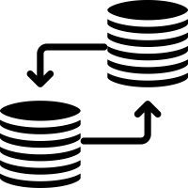




Replication
Packets
Authority
Abstraction
What is a game engine ?
External tools
Definition
1. Toolbox
Networking is a complex subject, even more in video game where it creates a lot of complication on the development side. Engine tends to abstract and hide as much as possible when it comes to network
2. AI
3. Input / output
4. Physics
open code
5. Rendering
Having access to source code when it comes to networking is really important to understand what is going on, how calls are made, etc…
6. UI
7. Network
8. Building & Shipping
Engine
9. Multi-platform
Some engine, like Unity, are bad when it comes to multiplayer, even if they promised a new networking environment. Some others,like Unreal, do better but all in all, a lot of works needs to be done

Slide 44
Abstraction
Packets
Authority
Replication
What is a game engine ?
External tools
Definition
1. Toolbox
Replication concept is quite straightforward in a network environment, it consists of ensuring that everyone is up to date with everyone else
2. AI
3. Input / output
4. Physics
Server
5. Rendering
Server is a key component in networking and replication. Basically, the server is responsible for being the place where replication will be dispatched into every clients (Or not)
6. UI
7. Network
8. Building & Shipping
Techniques
9. Multi-platform
Reliable, non-reliable, rpc, property replication, prediction, etc… there is a lot of concepts and techniques around which will not be covered in details

Slide 45
Abstraction
Replication
Authority
Packets
What is a game engine ?
External tools
Definition
1. Toolbox
Packets is the name given to message that passes on the network and contains the informations. It is also this concept of packets that is properly analyze when there is packets loss, performance issue, etc…
2. AI
3. Input / output
4. Physics
5. Rendering
6. UI
7. Network
8. Building & Shipping
9. Multi-platform

Slide 46
Abstraction
Replication
Packets
Authority
What is a game engine ?
External tools
Definition
1. Toolbox
The authority concept is primordial in a network environment. it will dictate if there is a validation check before setting some variable, if setting variable must be done on server, etc…
2. AI
3. Input / output
4. Physics
netmode
5. Rendering
A multiplayer game will always be associated with a netmode which indicate how authority and other stuff like ownership is driven.
6. UI
7. Network
8. Building & Shipping
Examples
9. Multi-platform
Basically, given every actor is spawned by server, when server is authoritative, every actor has authority on server side. But for example, a vfx spawned on a client has client for authority.

Slide 47
Abstraction
Replication
Packets
External tools
What is a game engine ?
Authority
Definition
1. Toolbox
When it comes to professional development for a multiplayer game, it will always requires externals tools like Gamelift, or similar, which will be responsible for storing datas, connection checking, etc...
2. AI
3. Input / output
4. Physics
5. Rendering
6. UI
7. Network
8. Building & Shipping
9. Multi-platform

Slide 48

What is a game engine ?
Building & Shipping

Slide 49



Transparent
Executable
Cooking
What is a game engine ?
Definition
1. Toolbox
Cooking is the action of converting assets like textures, audio files, etc… which have a specific format like JPEG, WAV, etc… into a comprehensive and formatted format for targeted platform
2. AI
3. Input / output
4. Physics
Goal
5. Rendering
Cooking is part of the building process, which aims to create a file / bunch of file that will be executable on the targeted platform
6. UI
7. Network
8. Building & Shipping
Exclusion & process
9. Multi-platform
Generally speaking, cooking process will only include assets that are implicitly references from scenes. Everything else will not be added, leading to errors / pink texture for example.

Slide 50
Cooking
Executable
Transparent
What is a game engine ?
Definition
1. Toolbox
Building process should be transparent or nearly transparent. The processus is driven by the platform you are building on, and engine are processing everything under the hood.
2. AI
3. Input / output
4. Physics
DLC & Updates
5. Rendering
It can become a complexe subject, but when you want to deploy an update or a DLC for a game, the idea is to only cooks modified and new asset in order to have a light update. Engine tries to handle that
6. UI
7. Network
8. Building & Shipping
9. Multi-platform

Slide 51
Cooking
Transparent
Executable
What is a game engine ?
Definition
1. Toolbox
The final result of a build will be an executable. Either a .exe, .pkg, etc… based on the platform but the final issue is similar. The executable will be able to be launched on the platform in order to play.
2. AI
3. Input / output
4. Physics
Testing
5. Rendering
Executables will be given to QA, manufacturer, etc… for the game to be tested. it is the only product that is awaited.
6. UI
7. Network
8. Building & Shipping
9. Multi-platform

Slide 52

What is a game engine ?
Multi-platform

Slide 53



API
Specificities
TRC
What is a game engine ?
Definition
1. Toolbox
TRC stands for Technical Requirement Checklists. This is a list of features that needs to be implemented for a platform.
2. AI
3. Input / output
4. Physics
Validation
5. Rendering
TRC are important to handle because your game will be refused by manufacturer if you can’t pass the checklist. It also means during development you need to be careful about abstraction
6. UI
7. Network
8. Building & Shipping
Examples
9. Multi-platform
Save corruption, achievements unlock, controller support, compatibility, etc…

Slide 54
TRC
Specificities
API
What is a game engine ?
Definition
1. Toolbox
Obviously, if there is TRC, it means you need to writes code that is specific for that engine. in order to achieve that, every console comes with an API provided by the manufacturer exposing console’s features
2. AI
3. Input / output
4. Physics
Wrapper
5. Rendering
APIs are nearly always written in C++(or console language), you’ll then have wrapper that will encapsulate that in order to be used in your engine, for example C# on unity
6. UI
7. Network
8. Building & Shipping
9. Multi-platform

Slide 55
TRC
API
Specificities
What is a game engine ?
Definition
1. Toolbox
Every engine is different when it comes to what they offer. For example, PS4 offers achievements while switch doesn’t. The way to implement things is different, etc…
2. AI
3. Input / output
4. Physics
Abstraction
5. Rendering
Each engine is different, it lead to develop properly abstraction about features on your game. Develop a way to unlock achievements regardless of the platform, and simply have a proper implementation
6. UI
7. Network
8. Building & Shipping
9. Multi-platform

Slide 56

Pros

Slide 57


Pros
Accessibility
small team
Cheap
Even if a game engine can look terrifying / over complicated at first because of everything that is already done and present, it is a false impression.
You’ll lose way more time to develop your own engine instead of learning fundamentals and basics of an engine.
A lot of big companies runs an in-house engine because they have the workforce for it.
Make no mistake, developing an engine needs a lot of developers fully focus on developing and improving the engine.
small teams cannot afford that
It goes with independent, in the long run, even if there is a fee apply by commercial engine, it is way cheaper than creating a new engine.
There is no secret why even big companies like blizzard, or CD Projekt use commercial engine for some games, or completely abandoned in-house engine.

Slide 58


Pros
Up-to-date
Gameplay focus
Transferable knowledge
That’s also one of the most important factor about using a commercial engine.
It will always be up-to-date with standards. even if engine are completely differents, a lot of companies are using them, so they need to stay competitive regarding other commercial engine.
As a game company, you want to deliver a game, something related to gameplay. A game engine is just a tool to deliver a game, but it is not the delivered product.
Having more time to focus on gameplay and mechanics of the game will increase the final quality of the game
General knowledge like issues, logically thinking, techniques for video games, etc… will be obviously transferable from any engine.
BUT having knowledge in a commercial engine will be fully transferable if you leave for another company that is using the same one.

Slide 59
Cons

Slide 60



Cons
Learning curve
Foundation
Dependant
That’s a reality for every game engine you’ll be using. There is always a learning cuve, which is related to the complexity of the engine.
THis learning curve can seems a big obstacle for some profile / team, which could lead to bad decisions or a fail in the project
It is kind of linked to the learning curve, but every engine comes with a base class foundation. In unreal unity this one is massive and explain for example the huge learning curve.
Anyway, this base will be inevitable and it can be seen as a cons for a team liking an engine except the foundation.
Even if engine ensure to stay up to date regarding features, there is still bugs and lacks in areas.
In that situation, you’ll be dependant from the engine developers, you’ll need to wait for patches and development if you encounter an issue and the engine is not open source.

Slide 61


Cons
Efficience
Documentation
An engine was not designed specifically for your game, so it may be less efficient than code you write specifically for your game.
It also comes with implication on network code for example which cannot be as optimize and specific as you would want. For example, MMORPG more than often completely rewrite network
In theory, there is documentation in any game engine which document code, features, etc…, and globally how to use any component provided by the engine
In reality, documentation is sometimes completely absent, often incomplete or unclear. This can leads to a lot of time lost, or needing to read source code.

Slide 62

Questions ?

